Slide 1
Customer
Personality
Analysis
Data Science Project 01
Group # 5

Slide 2
Problem Definition :
Need to perform clustering to summarize customer segments.
Data Set Details :
marketing_campaign1.csv
Team Member Details :
Vedant Ravindranath Kulkarni
Swapnil Sandeep Joshi
Shivani Appaso Patil
Sarvesh Ramesh Surve
Smruti Rekha Dash
Jeripothula Saimanideep
Aniruddha Naphad

Slide 3
Understanding the Data Set :
Data set contains information of the superstore sales having different product category and have approximately for 2 years. Details also includes promotions offered by store and its response from the customer on timely basis.
Summary :
29 features (variables)
2240 records of customers
Can be classified in 4 major attributes as described
Unsupervised learning classification problem

Slide 4
Understanding the Data Set : People
Name | Basic Description | Initial Observation | After Feature Engineering
ID | Customer's unique identifier | No nil or duplicate data observed | Not considered for Clustering analysis
Year Birth | Customer's birth year | Time base data need to converted to meaningful format | Age is calculated from given data and used for clustering analysis
Education | Customer's education level | Non numerical input with definite class observed | Two groups created 'UG = 0' and 'PG =1' , since showing good relationship with Kids attribute not considered for clustering analysis
Marital Status | Customer's marital status | Non numerical input with definite class observed | Two groups created 'Single = 0' and 'Partner =1' , since showing good relationship with Kids attribute not considered for clustering analysis
Income | Customer's yearly household income | 24 nil values observed | Null values (replaced with Mean) ,outliers are removed and considered for clustering analysis

Slide 5
Understanding the Data Set : People
Name | Basic Description | Initial Observation | After Feature Engineering
Kid home | Number of children in customer's household | Non numerical input with definite class observed | Combined to form one attribute and considered for clustering analysis
Teen home | Number of teenagers in customer's household | Non numerical input with definite class observed
Dt_Customer | Date of customer's enrolment with the company | Time base data need to converted to meaningful format | Customer Retention feature derived from date calculation in months
Recency | Number of days since customer's last purchase | No nil or duplicate data observed | Ignored for clustering analysis
Complain | 1 if the customer complained in the last 2 years, 0 otherwise | 0 and 1 format data, mostly not useful | Ignored for clustering analysis

Slide 6
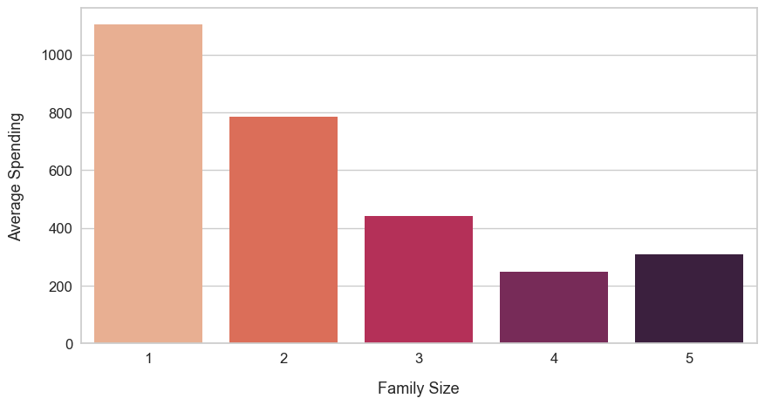
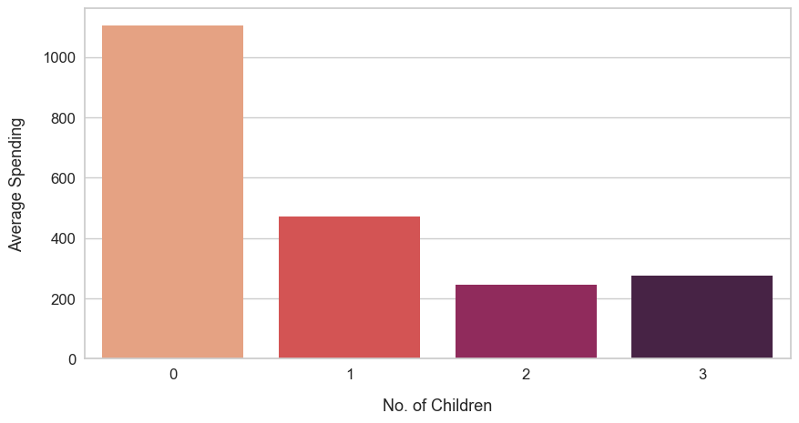
Understanding the Data Set : People
Family Size : Sum of total kids (Teens + Kids) + parents (Single or tougher)
No of Childrens :
Both the attributes shows similar trend so one with the minimum variations (No of kids) is selected

Slide 7
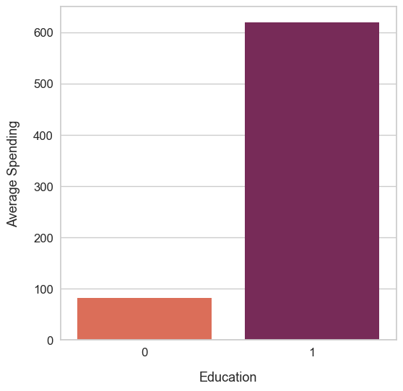
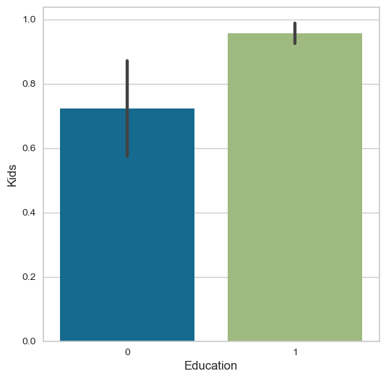
Understanding the Data Set : People
Education # 1 are representing customers who are post graduate (Highly educated)
Since expense vs kids and expenses vs income both show same trend , Education feature is not considered for clustering analysis

Slide 8
Data Analysis and Feature Engineering : Product
Name | Basic Description | Initial Observation | After FE and Data Cleaning
MntWines | Amount spent on wine in last 2 years | No nill or duplicate data is found in this features, however outlier needs to be removed to get consistent and predictable results. | After outlier removal and basic data cleaning , new feature "Total Spending " is created and used for clustering analysis.
MntFruits | Amount spent on Fruits in last 2 years
MntMeatProducts | Amount spent on Meat in last 2 years
MntFishProducts | Amount spent on Fish in last 2 years
MntSweetProducts | Amount spent on Sweets in last 2 years
MntGoldProds | Amount spent on gold products in last 2 years

Slide 9
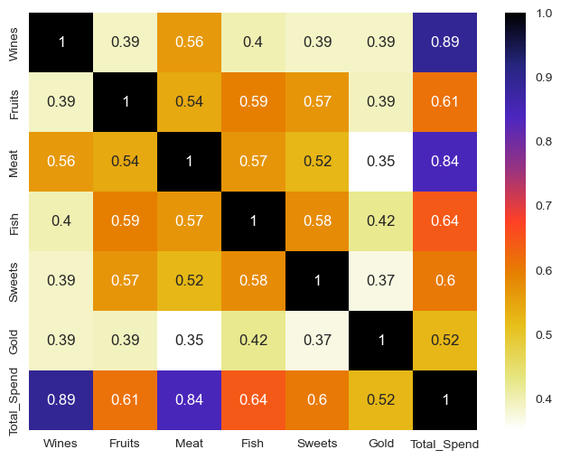
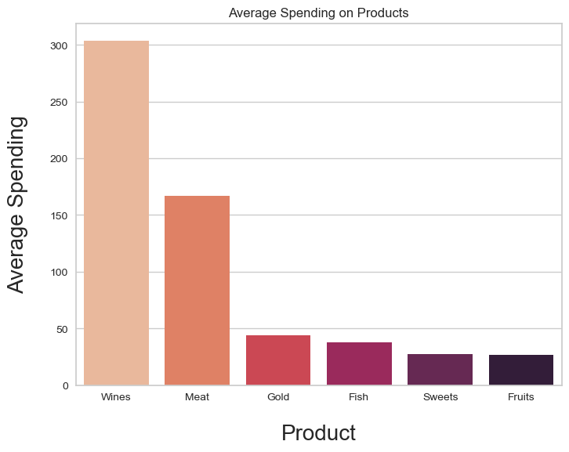
Data Analysis and Feature Engineering : Product
Above study shows Total spending have high correlation with meat and wine.
Wine and meat have high share in total spending.
So we can drop all product column and have Total Spending as representation of product.

Slide 10
Data Analysis and Feature Engineering : Places
Name | Basic Description | Initial Observation | After FE and Data Cleaning
NumWebPurchases | Number of purchases made through the company’s website. | No nill or duplicate data is found in this features | Initially taken for clustering analysis, but do not have any positive impact of number of clusters so neglected in clustering analysis. However considering importance of the data this features are used to get insights of generated clusters.
NumCatalogPurchases | Number of purchases made using a catalogue.
NumStorePurchases | Number of purchases made directly in stores.
NumWebVisitsMonth | Number of visits to company’s website in the last month.

Slide 11
Data Analysis and Feature Engineering : Promotion
Name | Basic Description | Initial Observation | After FE and Data Cleaning
NumDealsPurchases | Number of purchases made with a discount. | No nill or duplicate data is found in this features | Initially taken for clustering analysis, but do not have any positive impact of number of clusters so neglected in clustering analysis. However considering importance of the data this features are used to get details of clusters.
AcceptedCmp1 | 1 if customer accepted the offer in the mentioned campaign, 0 otherwise.
AcceptedCmp2
AcceptedCmp3
AcceptedCmp4
AcceptedCmp5
Response | 1 if customer accepted the offer in the last campaign, 0 otherwise.

Slide 12
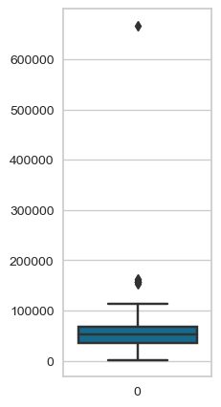
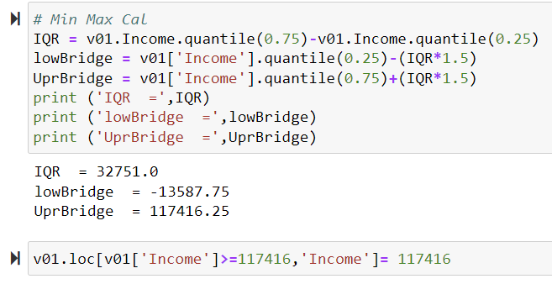
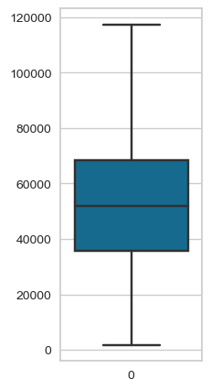
Data Analysis and Feature Engineering :
Outlier detection and removal :
Box plot and IQR calculations are used to calculate Upper bridge
All values above upper limit are replaced with upper limit
Before
After

Slide 13
Data Clustering :
Feature Selection and Scaling :
Standard scalar
Min Max scaler
Algorithm Studied :
Hierarchical Clustering :
DBSCAN :
KMeans :
Evaluation Parameters :
Inertia Score
Silhouette Score
Physical significance and ease of understanding
Data clustering is iterative process and based on multiple observations and studies we have finalised KMeans clustering algorithm. Evaluation is mostly done on physical significance and practical approach.

Slide 14
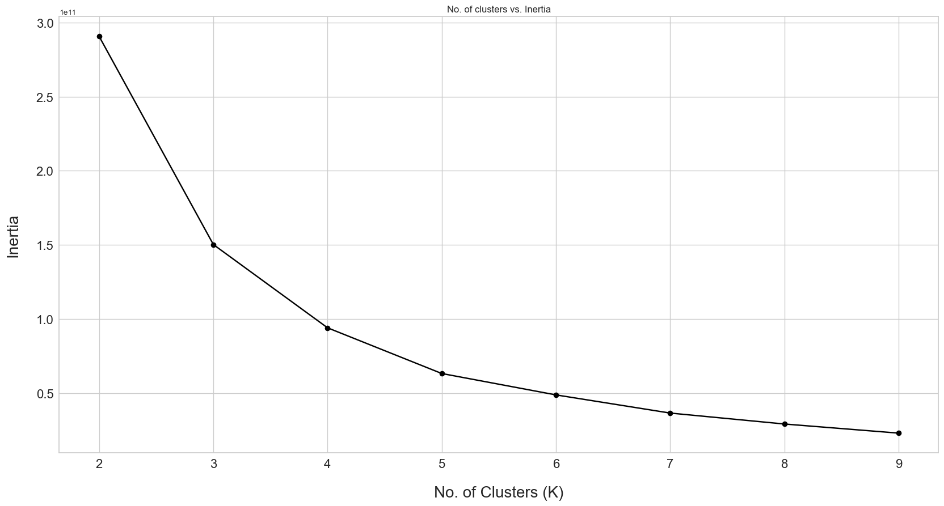
Data Clustering : KMeans Algorithm
Based on Elbow curve method (Inertia calculation) optimum number of cluster suggested are 3 and 4.
But on further studies we observed 4 cluster are needed to get the clear and practical division of customer on multiple available features.
Feature Selected for Clustering
Income of Customer
Age of Customer
Number of Kids
Customer Retention (Months)
Total Spending (Product)

Slide 15
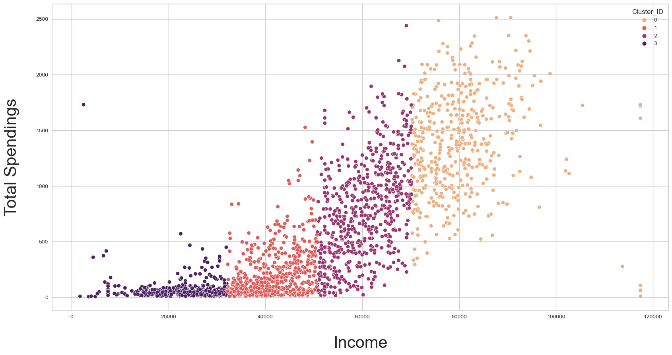
Data Clustering : Results
Considering Income as main factor algorithm have suggested 4 main clusters.

Slide 16
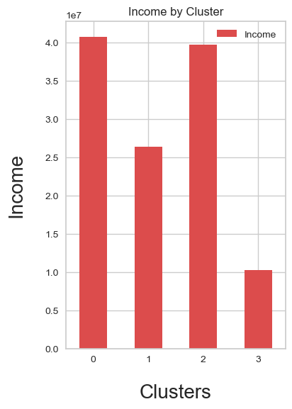
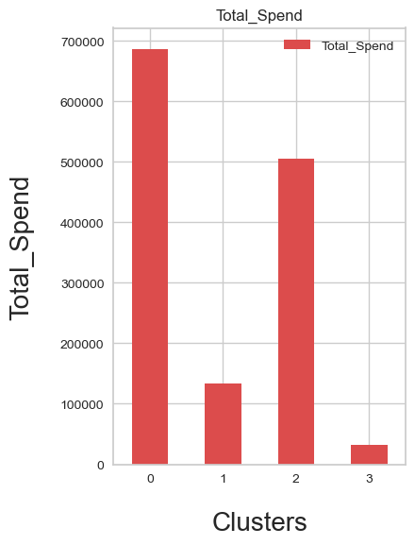
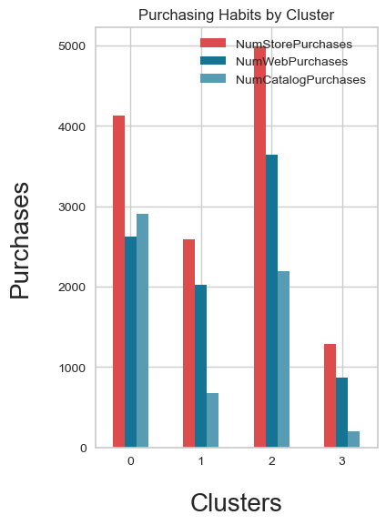
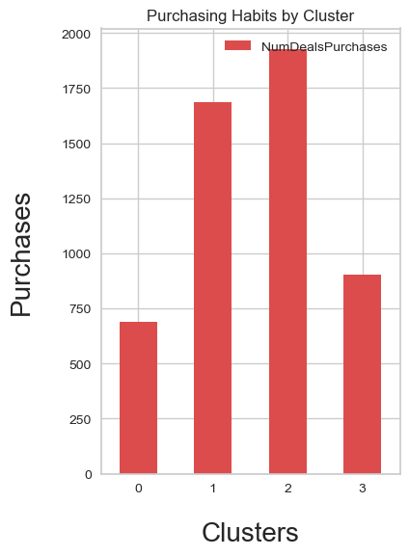
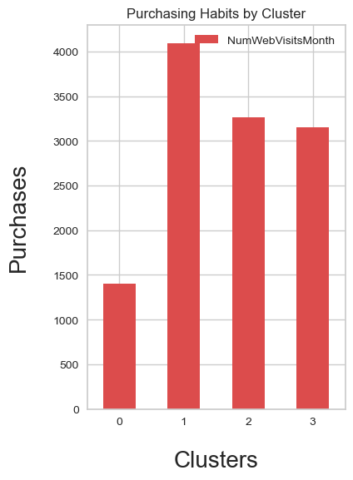
Data Clustering : Results
People
Product
Place
Promotion
Cluster ID 0 :
Highest income and Spending, lowest response to deals
Cluster ID 2 :
Second highest Income , Spending and highest response to deals
Cluster ID 1 :
Low income , spending but second highest response to deals and shows highest web visits
(Need to promote more deals to this group)
Cluster ID 3 :
Lowest income, spending but shows reasonable response to deals
Cluster ID = 0 = Platinum
Cluster ID = 2 = Gold
Cluster ID = 1 = Sliver
Cluster ID = 3 = Bronze

